Slide 1
Analyzing the Potential Impact of Robotic Process Automation and Artificial Intelligence on the Education Sector: Opportunities, Challenges, and Implications
Chase Hunter
CIS 4950
5/4/23
10:00 - 10:30 am

Slide 2
Introduction
For generations, education has relied on traditional teaching methods as the standard. The lecture-style classroom, textbooks, and written exams have been entrenched in the educational landscape. While these methods have demonstrated their efficacy, they possess certain limitations
Since the COVID-19 pandemic, students have become more accustomed to online learning, and now it is often seen as a regular part of student education
With this in mind, it opens the door to many new opportunities in the education sector, including implementing robotic process automation and artificial intelligence without overwhelming the teachers and students

Slide 3
What is Robotic Process Automation (RPA)?
What is it used for?
Robotic Process Automation, otherwise known as RPA, involves using computer software to automate repetitive tasks, with the overall goal to increase efficiency and reduce errors
With RPA solutions on the rise, it is actually seen in almost all industries, but more so those that include frequent repetitive tasks
RPA is most commonly seen in insurance, banking, finance, healthcare and telecommunications

Slide 4
How is RPA different from AI?
While the two may seem similar, they perform in different ways and have different uses
RPA uses structured inputs and logic that is provided by the user
AI uses unstructured inputs and typically will develop its own logic
Although they are not the same, RPA and AI can perform quite efficiently when paired together

Slide 5
What is the potential benefit of RPA and AI implementation in the education sector?
The use of RPA in education has been shown to have several potential benefits, including increased efficiency and accuracy in educational processes, enhanced interaction and engagement between students and teachers, and improved educational outcomes.
Notable Points
RPA can improve efficiency and effectiveness in the education sector, particularly administrative processes
Using RPA can help teachers save time and increase productivity, allowing them to focus more on teaching and student learning
RPA can provide personalized learning experiences and support teachers in providing tailored feedback to students
The integration of RPA in education has been shown to increase teacher satisfaction and motivation
Studies have shown the potential benefits of RPA in reducing errors and increasing accuracy in tasks such as grading and record keeping

Slide 6
What are some specific areas RPA and AI implementation could improve in education?
Any area with frequent repetitive tasks could benefit from RPA and AI implementation
In the following slides, I will be covering four specific areas:
Scheduling
Student Learning Experience
Financial Aid Processing
Student Information Management

Slide 7
Scheduling
Potential Benefits:
Enhanced schedule optimization
Real-time schedule adjustments
Predictive analytics
Reduced administrative workload
Optimize schedules more effectively than traditional algorithms
More customized and efficient schedules
Enhanced student and teacher satisfaction
More efficient educational experience
Potential Risks:
Perpetuating Discrimination
Reducing role of human educators and administrators
Technical issues that could cause disruptions

Slide 8
Student Learning Experience
Potential Benefits:
Personalized Learning
Intelligent Tutoring
Customized Content Curation
Automated Grading
Predictive Analytics
Potential Risks:
Hindered critical thinking and problem-solving skills
Privacy and security concerns
Biases perpetuated in the learning experience
Unknown future for students learning via AI/Automation practices

Slide 9
Financial Aid Processing
Potential Benefits:
Increased efficiency, accuracy, personalization, and fraud detection
Automated verification and eligibility determination
Reduced workload for financial aid officers
Accelerated Financial Aid process
Personalized recommendations depending on specific financial situations
Potential Risks:
Biased decision-making due to inaccurate and unfair data collection and analysis
System algorithms may exclude students with certain unique circumstances
Complex technology may leave students confused when navigating application process
Reduce opportunities for human employees and their professional development
Privacy and security concerns regarding personal information

Slide 10
Student Information Management
Potential Benefits:
Automated administrative tasks
Predictive analytics
Early warning systems for at-risk students
Identify patterns and trends to provide customized learning experiences
Use information collected to anticipate future outcomes
Potential Risks:
Accuracy of data gathered
Confidentiality and safety of personal student information
Unintended prejudice or unfairness
Job cuts for human employees who manage pre-existing student information system

Slide 11
Recap
Many potential benefits to RPA and AI implementation in these four education systems
Also many potential risks to consider
Does the benefit outweigh the risks?
Does the risks outweigh the benefits?

Slide 12
Risk-Benefit Analysis
Scheduling:
AI algorithms and process automation can optimize school schedules and reduce workload
But also poses risks such as perpetuating discriminatory biases and reducing human involvement
Mitigation measures, such as transparency, accountability, and human oversight are necessary for fair and effective scheduling process
Benefits of implementation outweigh the potential risks
Student Learning Experience:
RPA and AI implementations can offer benefits like personalized learning and automated grading
But implementation also poses risks like hindering critical thinking
Transparency and collaboration with human educators are crucial to mitigate risks
Implementing RPA and AI in the student learning experience is worthwhile as long as the risks are adequately addressed, and benefits are applied responsibly
Financial Aid Processing:
RPA and AI implementations in financial aid processing may have biased decision-making, decreased access, and job loss issues
Careful consideration required to determine if benefits outweigh the risks, including mitigating biases, and protecting privacy and security.
Responsible use is crucial, balancing benefits and risks, implementing mitigation measures, and fostering critical thinking alongside AI-based learning.
Student Information Management:
RPA and AI in student information management can offer personalized learning, simplified tasks, and early warning systems.
Risks include but may not be limited to, data accuracy, privacy concerns, and potential bias
Implementing RPA and AI in education may be worthwhile if risks are addressed and technology is used responsibly
Benefits outweigh risks if AI is designed to be inclusive, transparent, and protective

Slide 13
Implementation
Not many examples of RPA implementation in education for a variety of reasons
Organizations are unsure what tasks to focus their efforts on
Although, some RPA implementation has been attempted in the education sector with vastly positive results
See Institute of Engineering and Technology Wiley examples on next slide
Successful implementation shows substantial increase in operational efficiency
While implementation results are positive, development timelines are long and costly
Additional time needed for stabilization and training where necessary

Slide 14
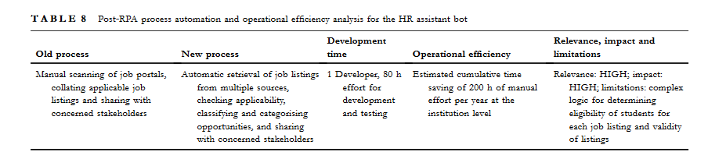
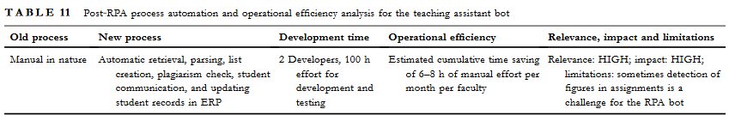
Prior RPA Implementation Examples & Results
Two successful implementation examples from the researches at IET Wiley
See significant gains in operational efficiency
While efficiency gains are high, so are development times

Slide 15
Implementation Cont.
In slide 7-10, I discussed the potential benefits and risks of RPA and AI implementation in four common school systems
Using this theoretical information, I created a prompt for OpenAI’s GPT-3.5 model to attempt to write code for these four systems
The following slides is the result I received when explaining a school scheduling system, financial aid processing system, and a student information management system, all with RPA and AI implementation
Note: The student learning experience was left out of this exercise due to the need for personalization depending on the specific situation

Slide 16
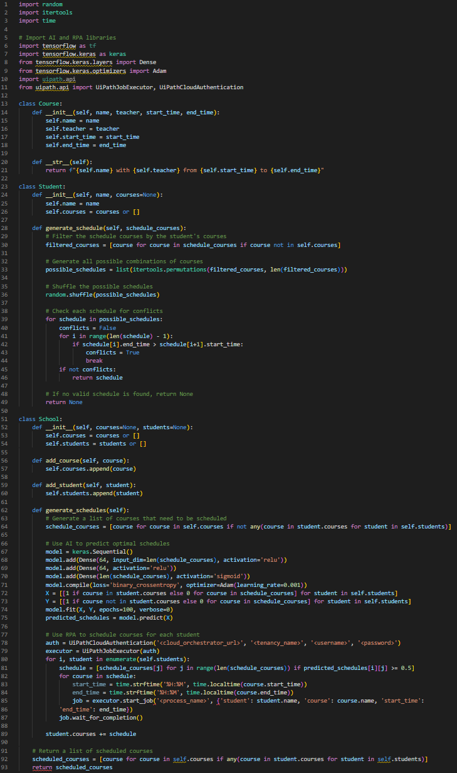
Figure 5.1b: Theoretical Scheduling System Code (WITH AI/RPA IMPLEMENTATION)
The system includes three classes: Course, Student, and School
The Course class represents a course with its name, teacher, start time, and end time
The Student class represents a student with their name and courses they are enrolled in
The School class represents a school with a list of courses and students
The generate_schedule method in the Student class generates a schedule for a student based on the courses that are not already taken by the student
It generates all possible combinations of courses and checks for conflicts in the schedule. If a valid schedule is found, it is returned. If not, None is returned
The generate_schedules method in the School class generates schedules for all students using AI to predict optimal schedules for each student
It creates a neural network model that takes in the courses each student is enrolled in as input and predicts the courses that they should take to maximize their schedule
RPA is used to schedule courses for each student, It creates a UiPathJobExecutor instance and starts a job for each course to be scheduled
The method returns a list of scheduled courses that are taken by at least one student
Theoretical Scheduling System (With AI/RPA Implementation)

Slide 17
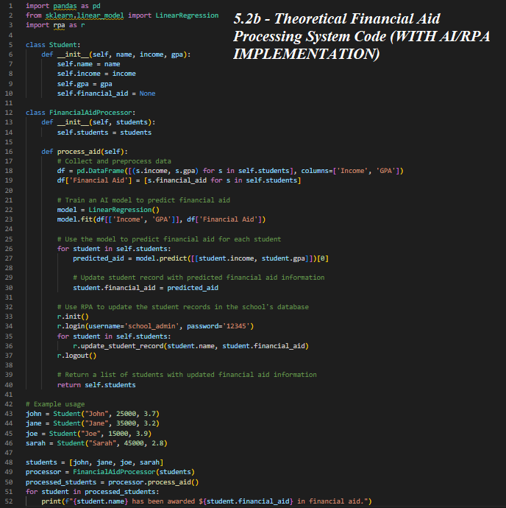
This code is for a school financial aid processing system that uses AI and RPA to predict and award financial aid to students
The Student class represents each student and their information, including income, GPA, and financial aid amount
The FinancialAidProcessor class processes financial aid for students using income and GPA information provided
Pandas library is used to collect and preprocess data for each student
Linear Regression AI model is used to predict the financial aid amount for each student based on income and GPA
RPA is used to update student records in the school's database with predicted financial aid information
The code returns a list of all students with their updated financial aid information
Example usage of the code creates four student objects with their respective information and passes them to the FinancialAidProcessor class.
Theoretical Financial Aid Processing System (With AI/RPA Implementation)

Slide 18
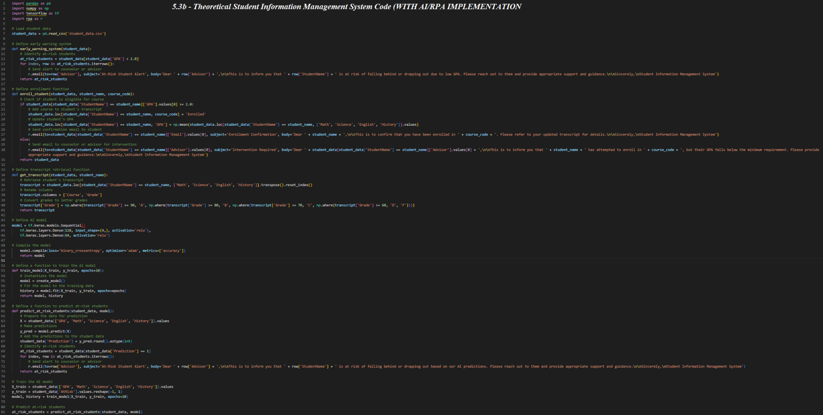
Code explanation on next slide..
Theoretical Student Information Management System (With AI/RPA Implementation)

Slide 19
This theoretical student information management system manages student information including names, GPA, courses, and grades, and has several useful features such as:
Early warning system for at-risk students
Enrollment function
Transcript retrieval function
AI model
The early warning system identifies at-risk students with a GPA below 2.0 and sends alerts to their counselor or advisor using the RPA library
The enrollment function checks eligibility for a course based on GPA, adds it to the student's transcript, and updates their GPA. Confirmation emails are sent to students and counselor intervention emails are sent if the student is not eligible
The transcript retrieval function retrieves a student's transcript, renames columns, and converts grades to letter grades
The AI model is a sequential model with two dense layers, it predicts at-risk students based on GPA and subject grades, the model is trained using the training data, and its predictions are added to student data
The predict_at_risk_students function sends alerts to counselors or advisors for each student predicted to be at risk of falling behind or dropping out based on AI predictions
This system is designed to help students stay on track with their education and provide appropriate support to those at risk of falling behind or dropping out
Theoretical Student Information Management System (With AI/RPA Implementation) Cont…

Slide 20
Implementation
Recap
While the previously shown code does not currently produce any quantifiable output, it does create a general idea of the work necessary to create the proposed system
Since there is no use case where these systems will be implemented, I will be using successful implementation timelines from researchers at The Institute of Engineering and Technology (IET) Wiley as a general reference
Eleven different implementation exercises were completed by researchers at IET Wiley (2 shown in slide 14), with development timelines ranging from 30 to 100 hours depending on the task
Using this information, I will estimate an average development and testing timeline of 74 hours for my proposed systems
Using the same eleven tests, I can estimate a timeline for testing and stabilization of my proposed systems of around 5 weeks
To estimate increases in operational efficiency, I will once again find an average from the known increases in operational efficiency found by researchers at IET Wiley
Using this information, I will estimate an average increase of around 134 hours per month for my proposed systems
Because these systems are all so different, I can not 100% rely on these estimates, but it does create a general idea of development timelines, testing timelines, and potential increases in operational efficiency
On the next slide I will cover the final important piece to be considered before implementation, ethical considerations

Slide 21
Ethical Considerations
Privacy:
Privacy is a potential ethical issue with proposed education technologies
Proposed tech has the ability to not only gather but also analyze large amounts of sensitive information
Information could potentially be used in an inappropriate manner or create new vulnerabilities in unforeseen cyber attacks
Careful consideration is needed from education executives and policymakers
Proper guidelines are necessary for data privacy and security
Bias:
Technologies can only be as unbiased as the data they are originally trained on
Data could reflect societal biases which would lead to AI technologies replicating said bias
Could lead to issues in areas like college admissions or student assessment
Retraining of RPA and AI algorithms necessary to minimize bias
Job Displacement:
While true that RPA and AI technologies can massively improve efficiency in administrative tasks
RPA and AI technologies also have the ability to replace jobs from humans that worked said position prior to implementation
These are vital implications to consider when implementing these technologies into the education workforce
Strategies must be put in place to mitigate the negative side effects of job displacement

Slide 22

Technical Demo
Basic Schedule UI with Automation

Slide 23
Conclusion
RPA and AI have the potential to revolutionize the education sector with significant advancements
Integrating RPA and AI in education can improve efficiency, personalization, and learning outcomes
Ethical and responsible utilization of these technologies is crucial, and concerns surrounding data privacy and security must be addressed
Further research and exploration is necessary to fully comprehend the potential of RPA and AI in education and ensure their responsible and effective deployment
Benefits of RPA and AI must be balanced with their ethical considerations to promote their successful implementation in education

Slide 24
Thank You
Chase M. Hunter
Department of Computer Science and Information Systems
University of North Georgia
Dahlonega, GA, United States of
America
cmhunt2679@ung.edu

